Slide 1
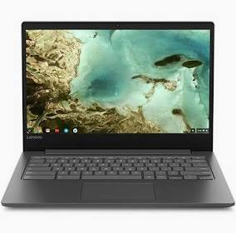
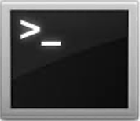

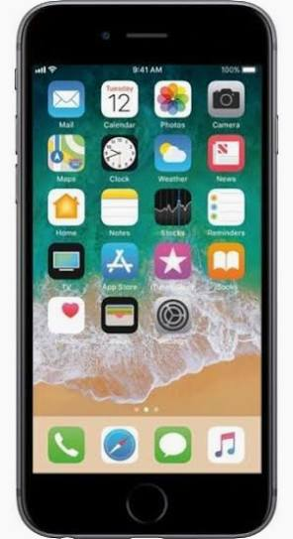

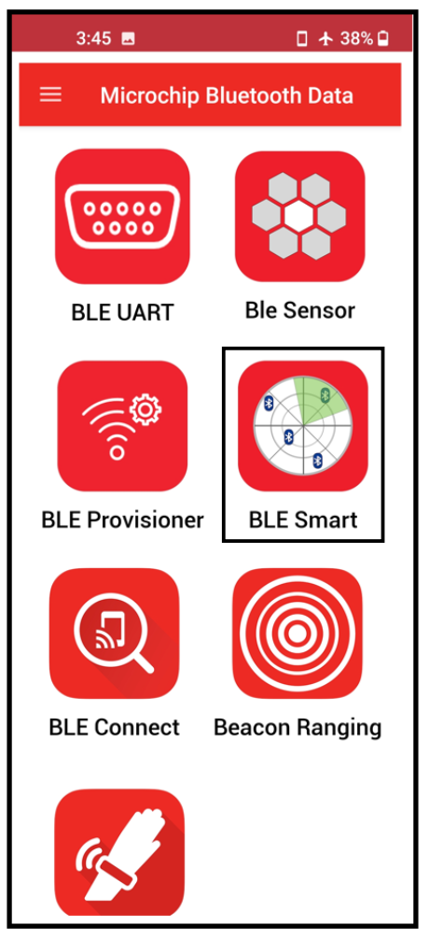

Microchip Demonstration Platform
(Cortex-M4F MCU, BLE Module, CAN XCVR)
USB
Host MCU
ATSAME51N19
TXD
CAN FD Transceiver
(PHY)
ATA6563
CAN BUS
RXD
BLE Certified RF Module
RNBD451PE
UART
BLE

Slide 2
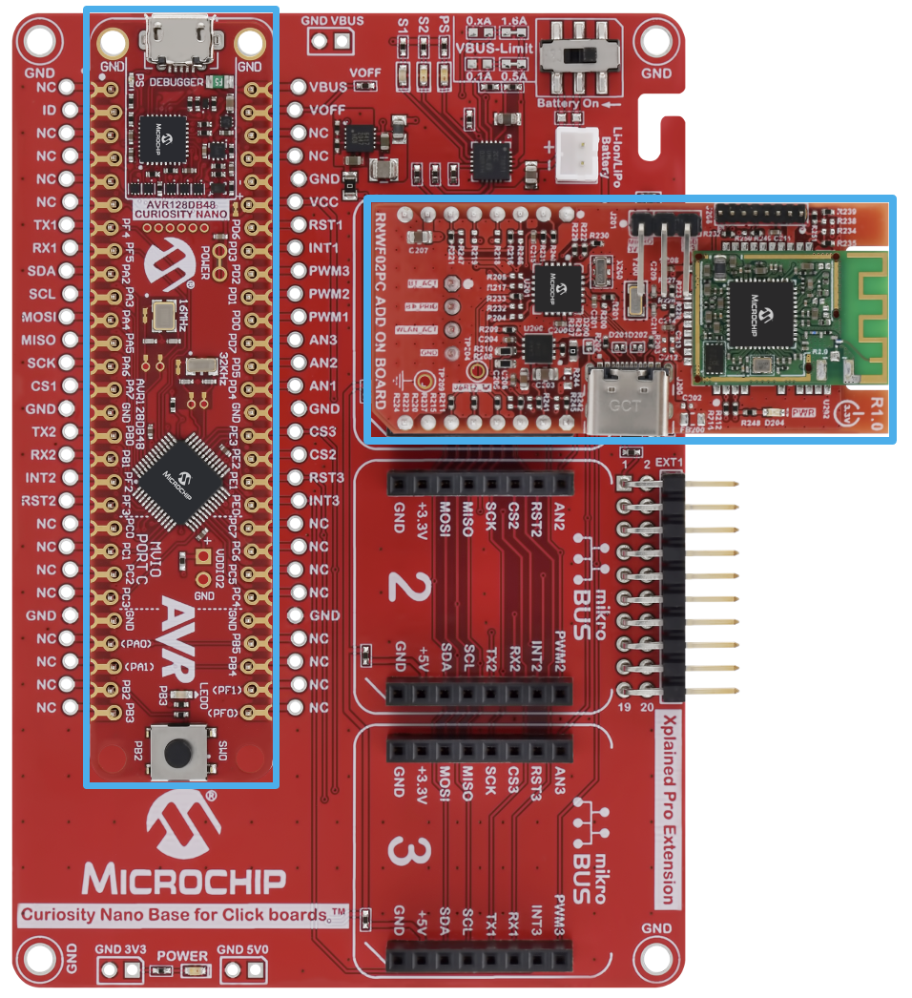
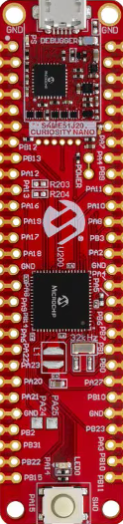
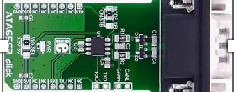
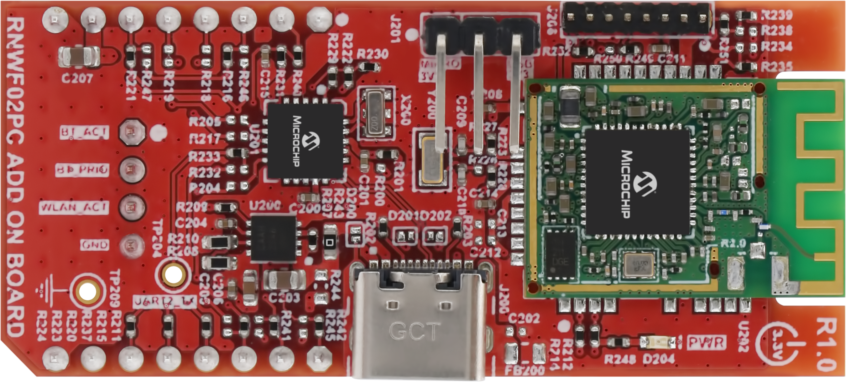
Microchip Demonstration Platform
Development Boards
1. Curiosity Nano Base
4. ATA6563 CAN XCVR Click
USB
CAN BUS
BLE
2. SAM E51 Curiosity Nano
3. RNBD451 BLE Add-On

Slide 3
Hardware Requirements
1. “Curiosity Nano Base for Click Boards” Evaluation Kit
https://www.microchip.com/en-us/development-tool/AC164162
2. SAM E51 Curiosity Nano Board
https://www.microchip.com/en-us/development-tool/EV76S68A
3. RNBD451 BLE Add On Board
https://www.microchip.com/en-us/development-tool/EV25F14A
4. ATA6563 CAN Transceiver Click Board
https://www.mikroe.com/ata6563-click

Slide 4
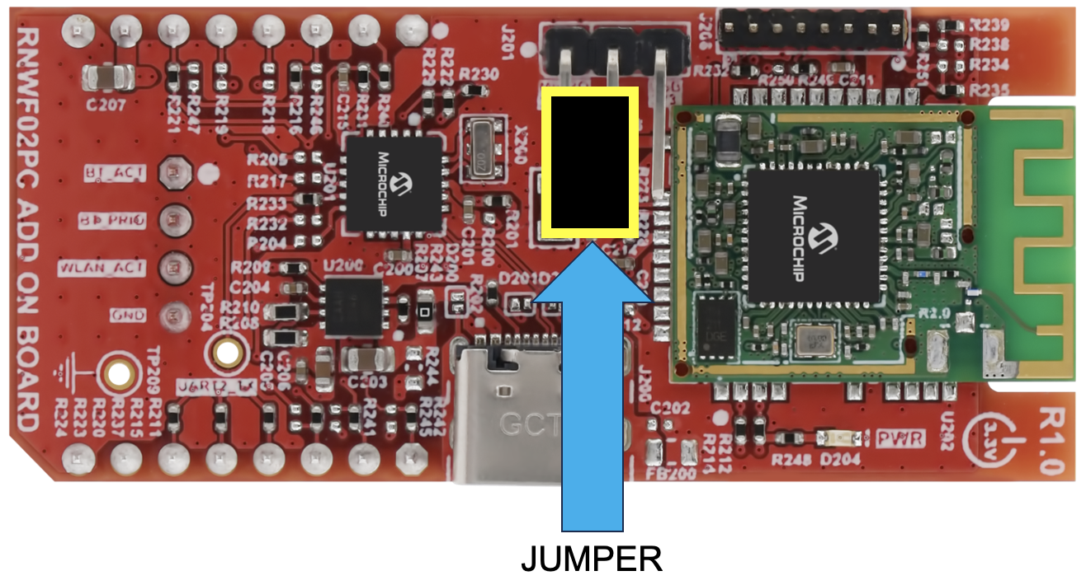
Hardware Setup (RNBD451 Add On Board)
RNBD451
BLE Module
Set the jumper so that the two pins furthest away from the RNBD451 BLE module are shorted

Slide 5
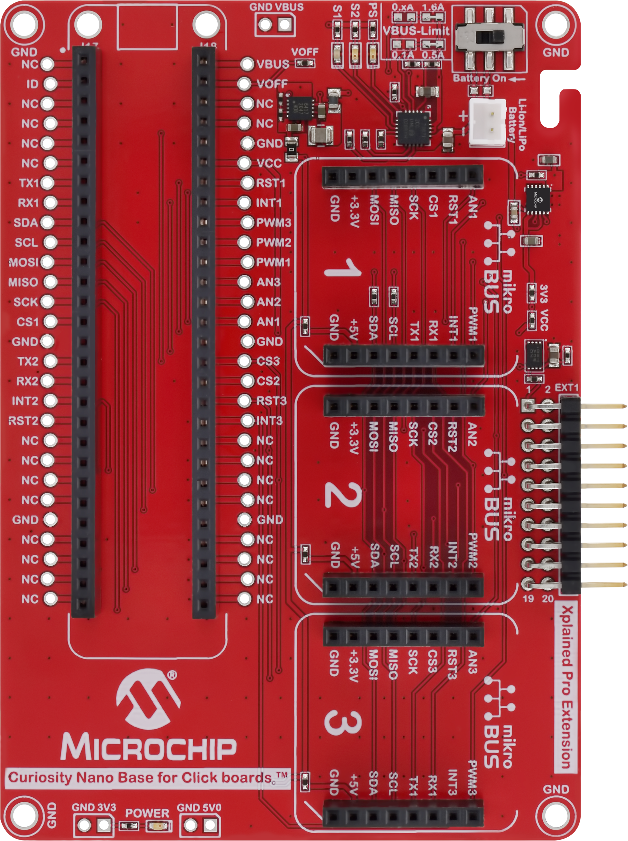
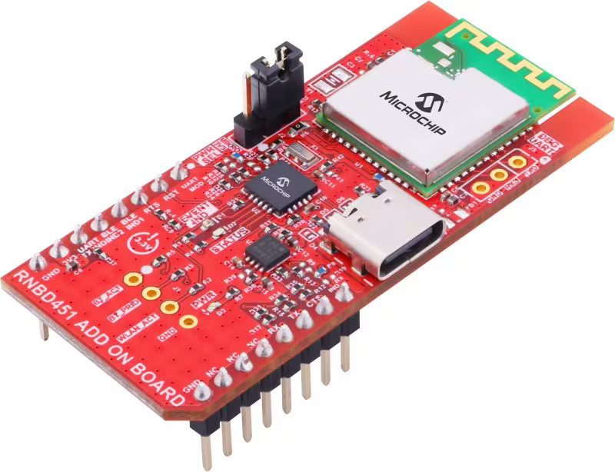
Hardware Setup (RNBD451 Add On Board)
Install the RNBD451 Add On Board onto mikroBUS socket #2 of the Curiosity Nano Base

Slide 6
Hardware Setup (SAM E51 Curiosity Nano)
Connect the supplied 28-pin headers underneath the SAM E51 Curiosity Nano (soldering is optional) and then install the SAM E51 Curiosity Nano onto the 56-pin socket of the Curiosity Nano Base

Slide 7
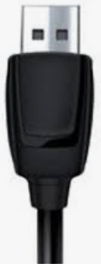
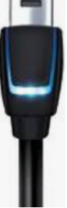
Hardware Setup (Host PC)
Connect the PC to the SAM E51 Curiosity Nano using a micro-USB cable and note the new Virtual COM port number that is associated with your connection (e.g. use the Windows Device Manager)

Slide 8
Hardware Setup (ATA6563 CAN XCVR)
Install the ATA6563 Click board onto mikroBUS socket #1 of the Curiosity Nano Base
https://www.mikroe.com/ata6563-click

Slide 9
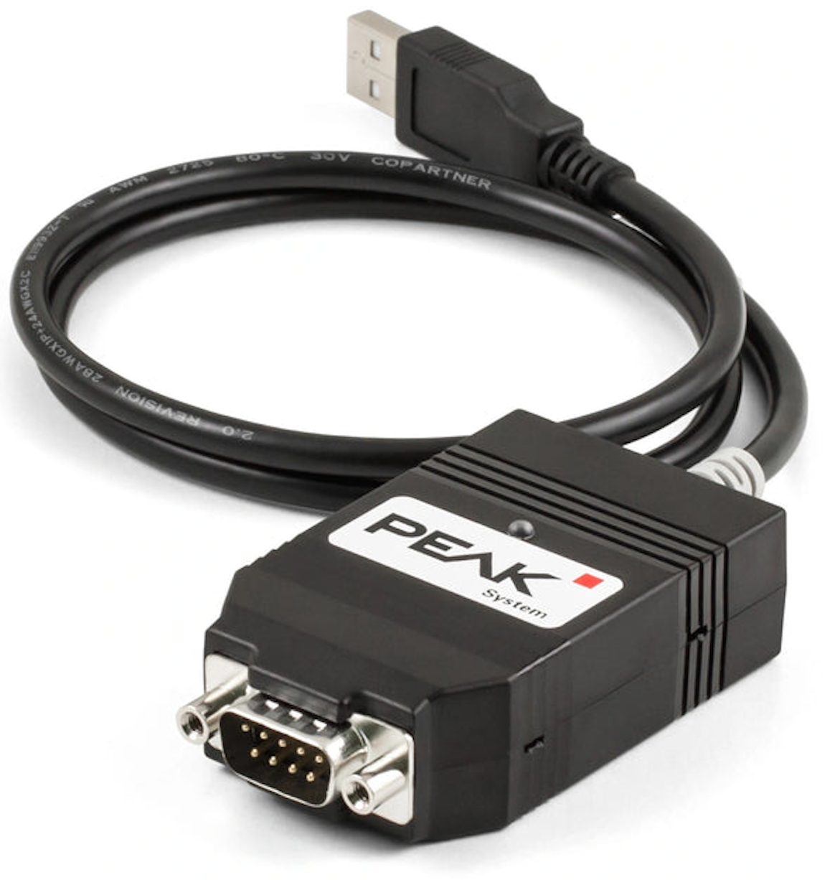
Hardware Setup (PCAN-USB FD Adapter)
DB9 SERIAL CABLE
Using a DB9 female-to-female serial cable, connect the PCAN-USB FD Adapter to the ATA6563 Click
Connect the USB cable of the PCAN-USB FD Adapter to an available USB port on the Host PC

Slide 10
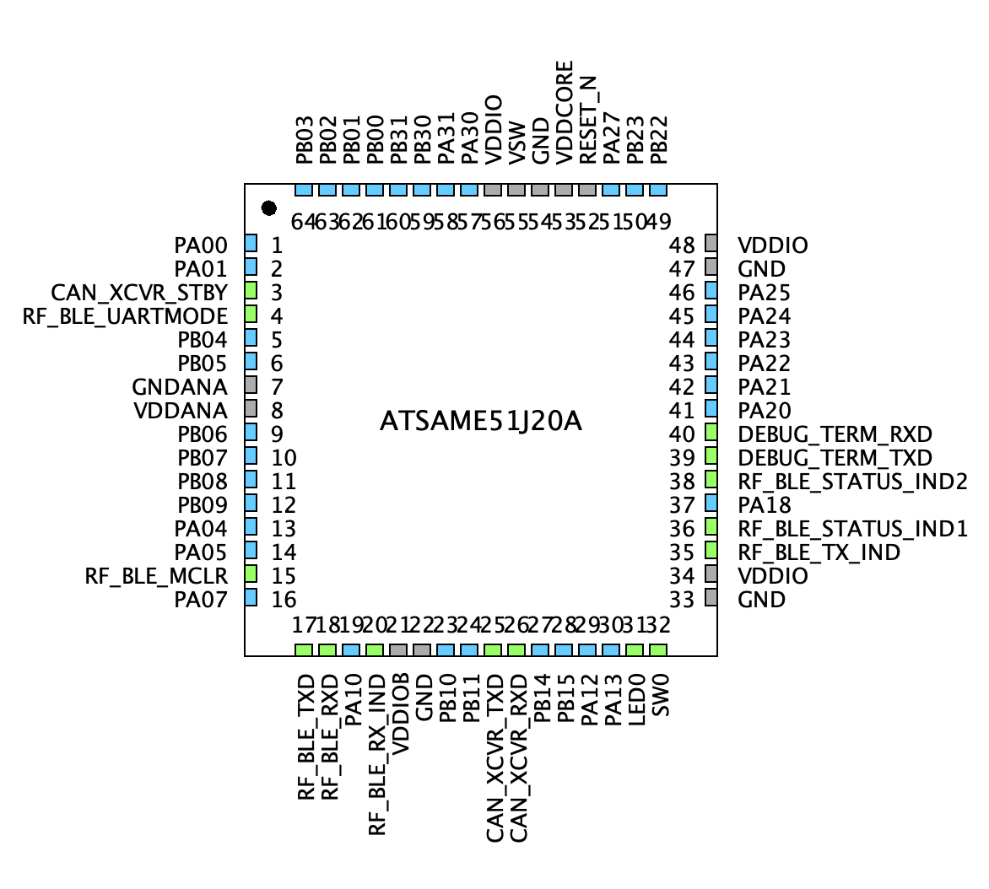
MCU Pin Assignment

Slide 11
Software Development Tools
1. MPLAB X IDE
https://www.microchip.com/en-us/tools-resources/develop/mplab-x-ide#tabs
2. XC32 Compiler
https://www.microchip.com/en-us/tools-resources/develop/mplab-xc-compilers/xc32
3. Microchip Bluetooth Data (MBD) Smartphone App
https://play.google.com/store/apps/details?id=com.microchip.bluetooth.data&hl=en_US&pli=1

Slide 12
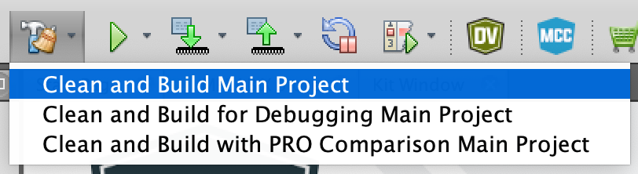
Demo Procedure
STEP 1: Launch the MPLAB X IDE
STEP 2: Open the Demo Project
From the MPLAB X main toolbar, select [File → Open Project]
Navigate to the CNANO_SAME51_RNBD451\same51n_rnbd451\firmware folder
Select (click on) the sam_e51_cnano_rnbd451.X project folder
Click on the Open Project button
STEP 3: Clean and Build the Project
Click on the Clean and Build Main Project icon in the MPLAB X main toolbar
CLICK

Slide 13
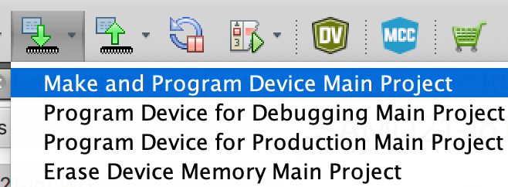
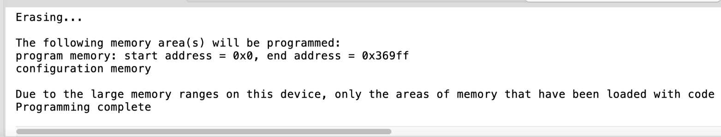
Demo Procedure
STEP 4: Program the ATSAME51 MCU
a) Click on the Make and Program Device Main Project icon in the MPLAB X main toolbar
b) Verify that the programming phase was successful
STEP 5: Connect to the RNBD451 Module Using the Microchip Bluetooth Data (MBD) Application
Follow the procedure outlined in Section 7.2.2.1 (“Text Mode”) of the RNBD451 Bluetooth Low Energy Module User’s Guide
https://onlinedocs.microchip.com/oxy/GUID-26457D23-798C-47B0-9F40-C5DA6E995C6F-en-US-2/GUID-4D5EDD33-45BA-469D-BB9F-DE40465F8E82.html
CLICK
CLICK

Slide 14
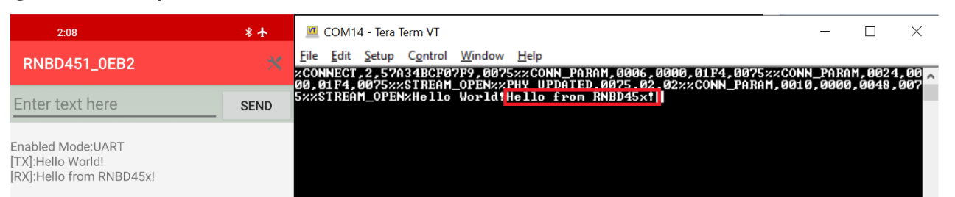
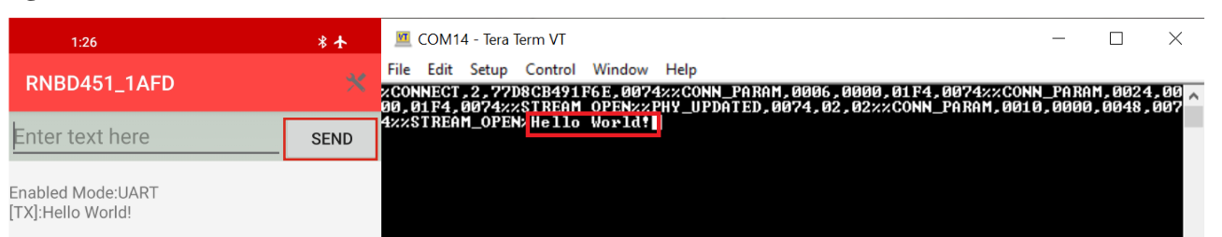
Demo Procedure
STEP 6: Change LED0 toggle rate
a) Press the SW0 button on the SAM E51 Curiosity Nano and note the LED toggle rate change
b) View the toggle rate confirmation messages in the Microchip Bluetooth Data (MBD) smartphone app
STEP 7: Send text messages from PC to Smartphone and vice versa
a) Type characters in the terminal window and confirm reception/display in the MBD app
b) Type characters in the MBD app and confirm reception/display in the terminal window

Slide 15
Creating Custom GATT Services
The RNBD451 module allows the user to create Bluetooth SIG-defined public GATT services as well as customer private services through simple UART commands. The specifications published by the Bluetooth SIG defines the public GATT services while the user defines their own private GATT services.
For an example, follow the procedure outlined in Section 7.3 (“Creating and Accessing GATT Services using UART Commands”) of the RNBD451 Bluetooth Low Energy Module User’s Guide
https://onlinedocs.microchip.com/oxy/GUID-26457D23-798C-47B0-9F40-C5DA6E995C6F-en-US-2/GUID-983D3FDA-5470-49F5-B8AC-E142DB5C1461.html
CLICK

Slide 16
Additional Resources
Harmony 3 Peripheral Library Application Examples for SAM D5X/E5X Family
https://github.com/Microchip-MPLAB-Harmony/csp_apps_sam_d5x_e5x
Create a New MPLAB Harmony v3 Project Using MPLAB Code Configurator (MCC)
https://developerhelp.microchip.com/xwiki/bin/view/software-tools/harmony/getting-started-training-module-using-mcc/

